Slide 1
Introduction to Next-generation sequencing
10.11.2021
Melanie Lang & Guillem Salazar

Slide 2
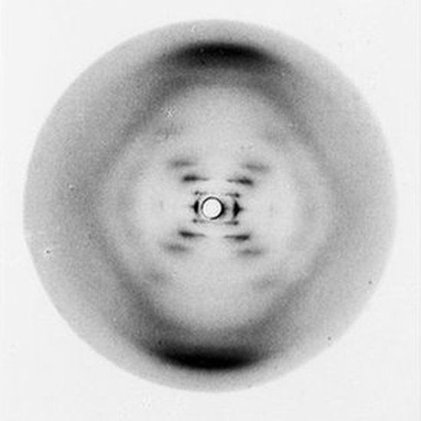
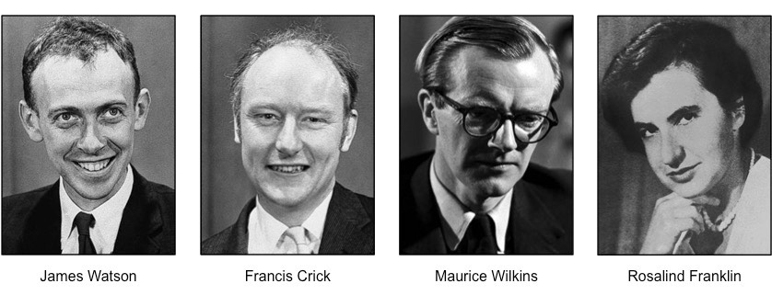
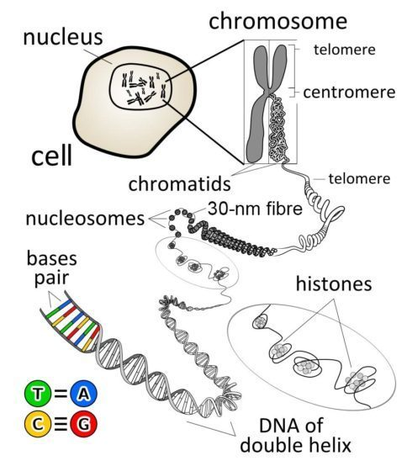
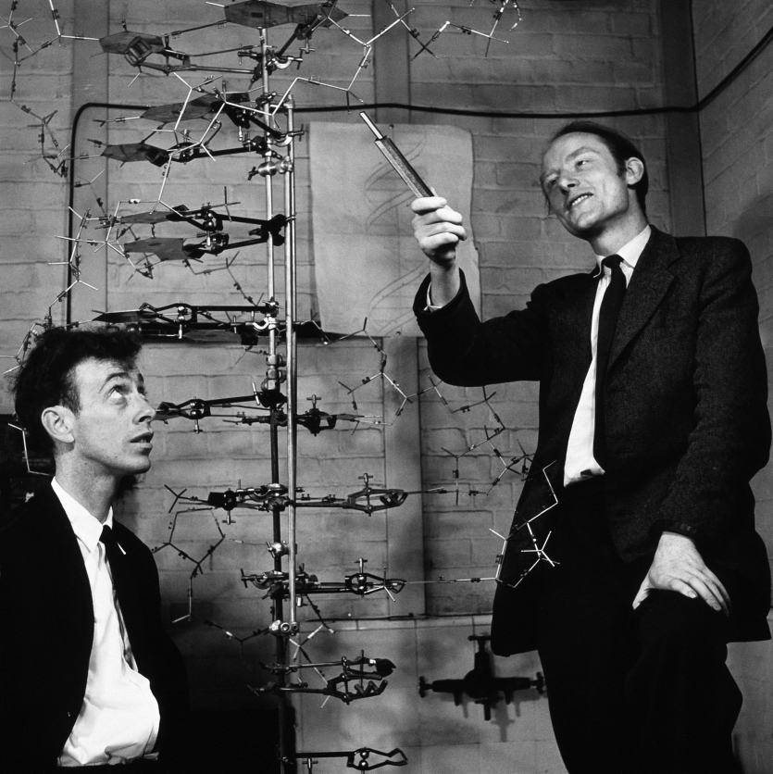
Origins of DNA sequencing
1953: Discovery of the structure of DNA
Photo 51
https://the-dna-universe.com/2020/11/02/a-journey-through-the-history-of-dna-sequencing/

Slide 3
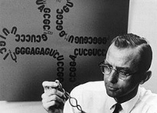
Origins of DNA sequencing
1953: Discovery of the structure of DNA
1965: “Sequencing” of the first tRNA
→ use of ribonucleases with cleaving sites at specific nucleotides
→ reconstruction of the original nucleotide sequence by determining the order in which small fragments occurred in the tRNA molecule
Robert W. Holley
https://the-dna-universe.com/2020/11/02/a-journey-through-the-history-of-dna-sequencing/

Slide 4
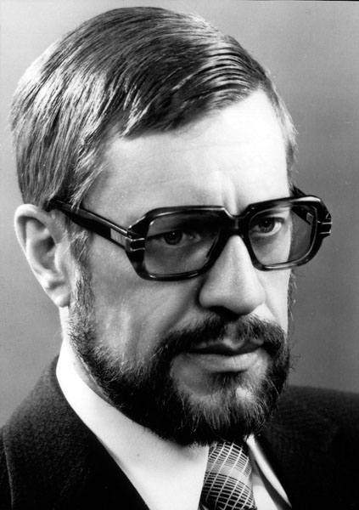
Origins of DNA sequencing
1953: Discovery of the structure of DNA
1965: “Sequencing” of the first tRNA
→ use of ribonucleases with cleaving sites at specific nucleotides
→ reconstruction of the original nucleotide sequence by determining the order in which small fragments occurred in the tRNA molecule
1972: Sequencing of first complete gene (coat protein of bacteriophage MS2) via RNAse digestion and isolation of oligonucleotides
Robert W. Holley
Walter Fiers
https://the-dna-universe.com/2020/11/02/a-journey-through-the-history-of-dna-sequencing/

Slide 5
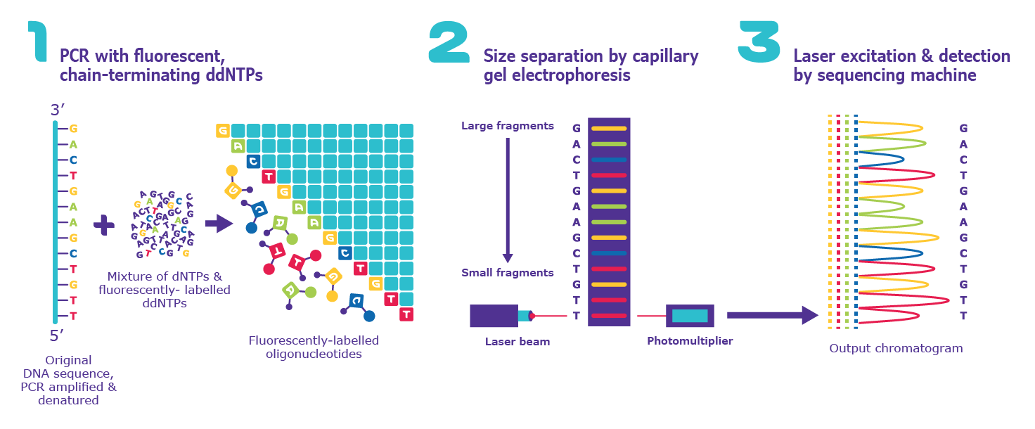
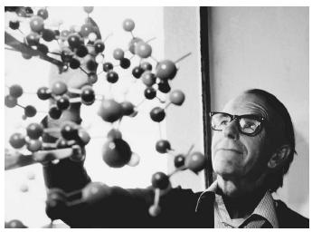
Origins of DNA sequencing
1953: Discovery of the structure of DNA
1965: “Sequencing” of the first tRNA
→ use of ribonucleases with cleaving sites at specific nucleotides
→ reconstruction of the original nucleotide sequence by determining the order in which small fragments occurred in the tRNA molecule
1972: Sequencing of first complete gene (coat protein of bacteriophage MS2) via RNAse digestion and isolation of oligonucleotides
1977: Release of “chain termination method” utilizing radiolabeled partially digested fragments → FIRST GENERATION SEQUENCING
Robert W. Holley
Walter Fiers
https://the-dna-universe.com/2020/11/02/a-journey-through-the-history-of-dna-sequencing/
Frederick Sanger

Slide 6
Origins of DNA sequencing
1953: Discovery of the structure of DNA
1965: “Sequencing” of the first tRNA
→ use of ribonucleases with cleaving sites at specific nucleotides
→ reconstruction of the original nucleotide sequence by determining the order in which small fragments occurred in the tRNA molecule
1972: Sequencing of first complete gene (coat protein of bacteriophage MS2) via RNAse digestion and isolation of oligonucleotides
1977: Release of “chain termination method” utilizing radiolabeled partially digested fragments → FIRST GENERATION SEQUENCING
Robert W. Holley
Walter Fiers
→ Main sequencing technology for next 25 years
→ Key innovations mainly in automation of wet-lab and data analysis pipelines
https://the-dna-universe.com/2020/11/02/a-journey-through-the-history-of-dna-sequencing/
Frederick Sanger

Slide 7
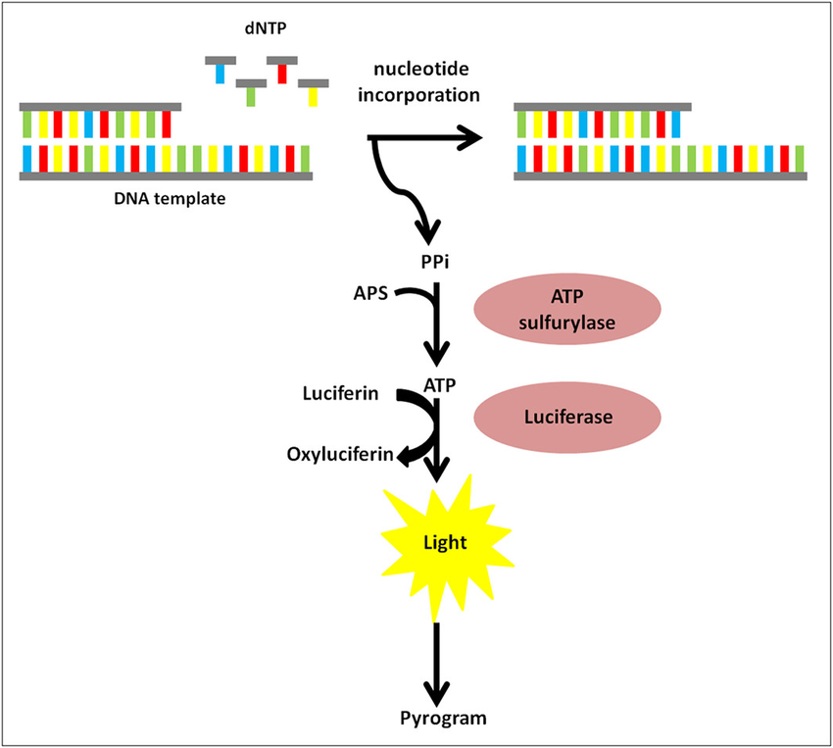
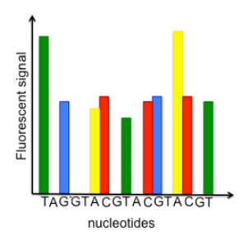
Origins of DNA sequencing
1996: Beginning of NEXT-GENERATION SEQUENCING
→ Pyrosequencing
PPi = Pyrophosphate
https://the-dna-universe.com/2020/11/02/a-journey-through-the-history-of-dna-sequencing/

Slide 8
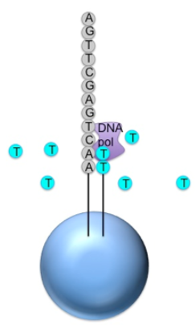

Origins of DNA sequencing
1996: Beginning of NEXT-GENERATION SEQUENCING
→ Pyrosequencing
PPi = Pyrophosphate
https://the-dna-universe.com/2020/11/02/a-journey-through-the-history-of-dna-sequencing/
https://www.ebi.ac.uk/training/online/courses/functional-genomics-ii-common-technologies-and-data-analysis-methods/next-generation-sequencing/454-sequencing/

Slide 9
Origins of DNA sequencing
1996: Beginning of NEXT-GENERATION SEQUENCING
→ Pyrosequencing
→Each read will have a different length because different numbers of nucleotides will be added during each wash
PPi = Pyrophosphate
https://the-dna-universe.com/2020/11/02/a-journey-through-the-history-of-dna-sequencing/
https://www.ebi.ac.uk/training/online/courses/functional-genomics-ii-common-technologies-and-data-analysis-methods/next-generation-sequencing/454-sequencing/

Slide 10
Origins of DNA sequencing
1996: Beginning of NEXT-GENERATION SEQUENCING
→ Pyrosequencing
→Each read will have a different length because different numbers of nucleotides will be added during each wash
Sequencing by synthesis
PPi = Pyrophosphate
https://the-dna-universe.com/2020/11/02/a-journey-through-the-history-of-dna-sequencing/
https://www.ebi.ac.uk/training/online/courses/functional-genomics-ii-common-technologies-and-data-analysis-methods/next-generation-sequencing/454-sequencing/

Slide 11
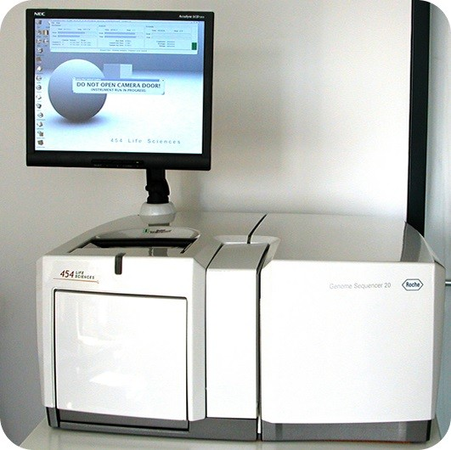
Origins of DNA sequencing
1996: Beginning of NEXT-GENERATION SEQUENCING
→ Pyrosequencing
2005: Implementation of pyrosequencing in automated system
→ 454 sequencing platform
Roche 454 Sequencing System
https://the-dna-universe.com/2020/11/02/a-journey-through-the-history-of-dna-sequencing/

Slide 12
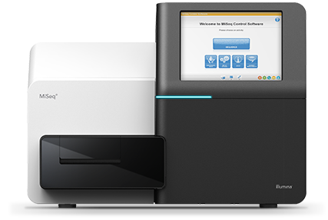
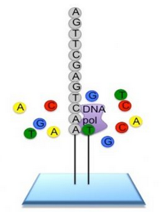
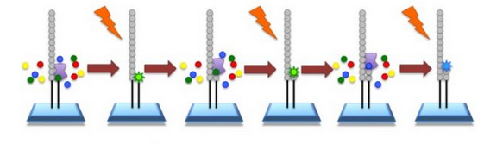
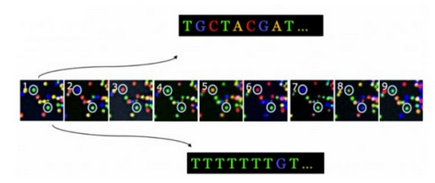
Origins of DNA sequencing
1996: Beginning of NEXT-GENERATION SEQUENCING
→ Pyrosequencing
2005: Implementation of pyrosequencing in automated system
→ 454 sequencing platform
2007: Illumina acquires Solexa
→ Advanced sequencing technology
→ Improved throughput
Illumina MiSeq Sequencing platform
In each cycle, one dNTP is incorporated into the reaction and it’s fluorescent signal captured in an image
Process is repeated until a full “read” is assembled
→ Single-stranded short DNA sequences are bound to a glass flow cell
→ Flow cell is flooded with fluorescently labelled dNTPs and polymerase
Translation of thousands of fluorescent images into a sequence read
https://the-dna-universe.com/2020/11/02/a-journey-through-the-history-of-dna-sequencing/
https://www.ebi.ac.uk/training/online/courses/functional-genomics-ii-common-technologies-and-data-analysis-methods/next-generation-sequencing/454-sequencing/

Slide 13
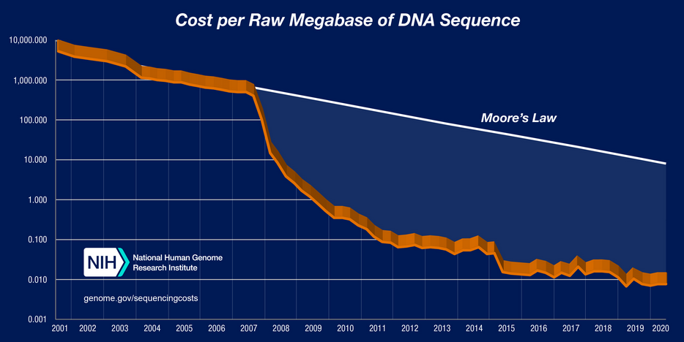
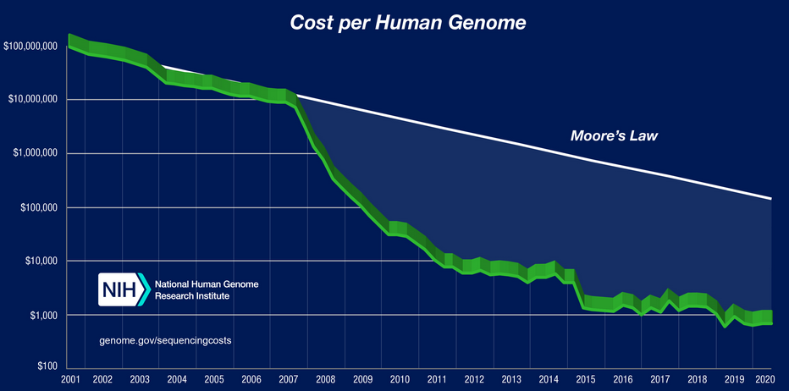
Origins of DNA sequencing
Improvements in DNA sequencing: Some numbers…
*
*
*Moore's law is an observation and projection of a historical trend. Rather than a law of physics, it is an empirical relationship linked to gains from experience in production
https://www.genome.gov/about-genomics/fact-sheets/DNA-Sequencing-Costs-Data

Slide 14
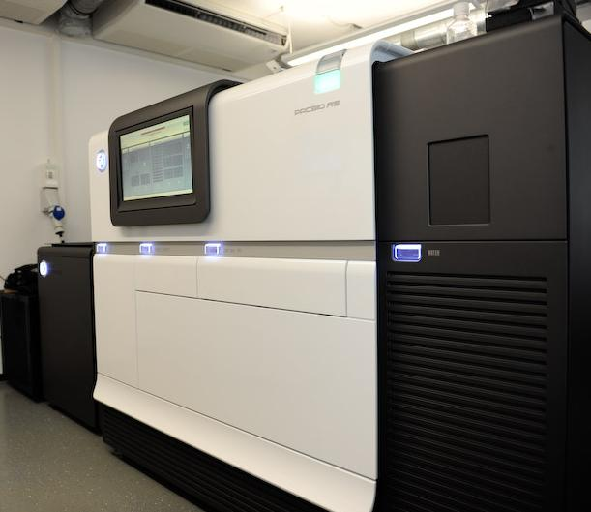
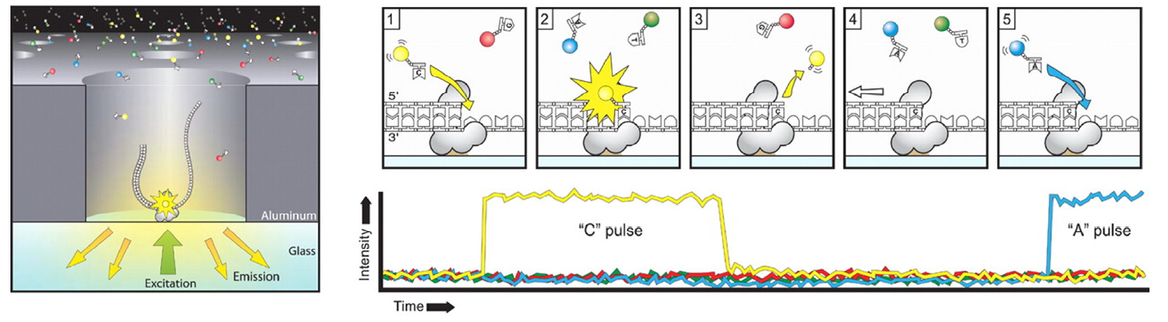
Origins of DNA sequencing
2010: Beginning of THIRD-GENERATION SEQUENCING
→ PacBio sequencing (Pacific Biosciences, Inc.)
PacBio RSII sequencer
→ polymerase immobilized at the bottom of a “well” (zero-mode waveguide ZMW) in a SMRTcell
Incorporation of fluorescent dNTPs produces a base-specific light pulse
Replication process in all ZMWs is recorded as a “movie” in real-time
https://the-dna-universe.com/2020/11/02/a-journey-through-the-history-of-dna-sequencing/
Rhoads & Au (2015) PacBio sequencing and its applications Genomics, Proteomics & Bioinformatics 13(5): 278-289

Slide 15
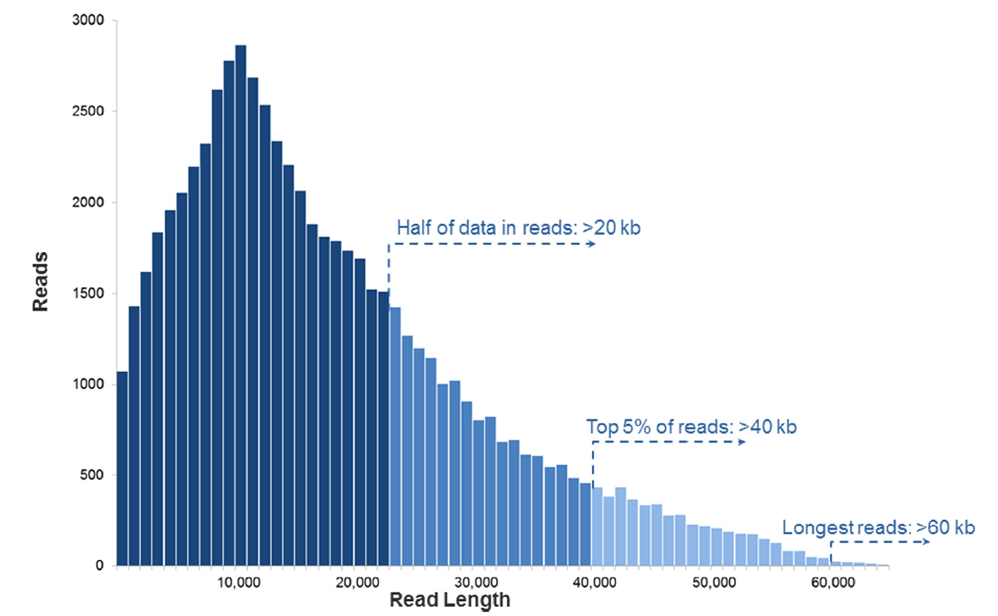
Origins of DNA sequencing
2010: Beginning of THIRD-GENERATION SEQUENCING
→ PacBio sequencing (Pacific Biosciences, Inc.)
→ Generation of long-reads!!
PacBio RSII sequencer
https://the-dna-universe.com/2020/11/02/a-journey-through-the-history-of-dna-sequencing/
Rhoads & Au (2015) PacBio sequencing and its applications Genomics, Proteomics & Bioinformatics 13(5): 278-289

Slide 16
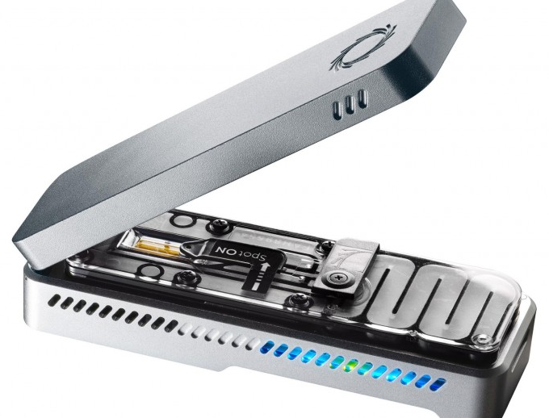
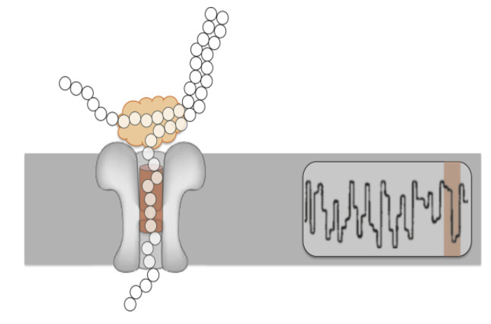
Origins of DNA sequencing
2010: Beginning of THIRD-GENERATION SEQUENCING
→ PacBio sequencing (Pacific Biosciences, Inc.)
→ Nanopore sequencing (Oxford Nanopore Technologies)
Nanopore MinION
single-stranded DNA/RNA molecules pass through protein nanopore
Each nucleotide that passes the pore leads to a different change in electrical current across pore
Resulting signal is decoded to provide sequence information
https://the-dna-universe.com/2020/11/02/a-journey-through-the-history-of-dna-sequencing/
https://www.sciencedirect.com/topics/neuroscience/nanopore-sequencing
https://nanoporetech.com/applications/dna-nanopore-sequencing

Slide 17
Origins of DNA sequencing
2010: Beginning of THIRD-GENERATION SEQUENCING
→ PacBio sequencing (Pacific Biosciences, Inc.)
→ Nanopore sequencing (Oxford Nanopore Technologies)
Nanopore MinION
Generation of ultra-long reads (2Mb)!!
single-stranded DNA/RNA molecules pass through protein nanopore
Each nucleotide that passes the pore leads to a different change in electrical current across pore
Resulting signal is decoded to provide sequence information
https://the-dna-universe.com/2020/11/02/a-journey-through-the-history-of-dna-sequencing/
https://www.sciencedirect.com/topics/neuroscience/nanopore-sequencing
https://nanoporetech.com/applications/dna-nanopore-sequencing

Slide 18
See also: https://www.nature.com/immersive/d42859-020-00099-0/index.html for milestones of genome sequencing…
https://www.genome.gov/about-genomics/fact-sheets/DNA-Sequencing-Costs-Data

Slide 19
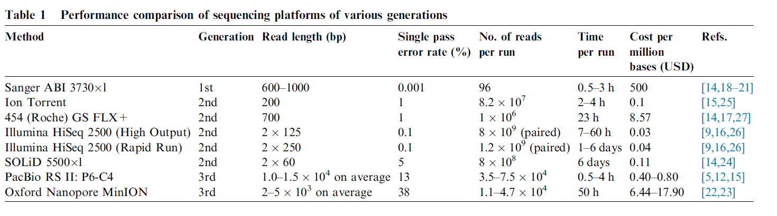
Origins of DNA sequencing: Platform comparison
→ Numbers outdated, main features still remain!
Rhoads & Au (2015) PacBio sequencing and its applications Genomics, Proteomics & Bioinformatics 13(5): 278-289

Slide 20
Origins of DNA sequencing: Platform comparison
Variable (medium) read length, ultra-accurate, low-medium throughput
Numbers are outdated, main features still remain!
Rhoads & Au (2015) PacBio sequencing and its applications Genomics, Proteomics & Bioinformatics 13(5): 278-289

Slide 21
Origins of DNA sequencing: Platform comparison
Variable (medium) read length, ultra-accurate, low-medium throughput
Fixed short read length, high accuracy, high/ultra-high throughput
Numbers are outdated, main features still remain!
Rhoads & Au (2015) PacBio sequencing and its applications Genomics, Proteomics & Bioinformatics 13(5): 278-289

Slide 22
Origins of DNA sequencing: Platform comparison
Variable (medium) read length, ultra-accurate, low-medium throughput
Fixed short read length, high accuracy, high/ultra-high throughput
Variable long read length, low/medium accuracy, medium/high throughput
Numbers are outdated, main features still remain!
Rhoads & Au (2015) PacBio sequencing and its applications Genomics, Proteomics & Bioinformatics 13(5): 278-289

Slide 23
Origins of DNA sequencing: Platform comparison
Variable (medium) read length, ultra-accurate, low-medium throughput
Fixed short read length, high accuracy, high/ultra-high throughput
Variable long read length, low/medium accuracy, medium/high throughput
Numbers are outdated, main features still remain!
Platforms of all generations still in use today…
Rhoads & Au (2015) PacBio sequencing and its applications Genomics, Proteomics & Bioinformatics 13(5): 278-289

Slide 24

Origins of DNA sequencing: Platform comparison
Variable (medium) read length, ultra-accurate, low-medium throughput
Fixed short read length, high accuracy, high/ultra-high throughput
Variable long read length, low/medium accuracy, medium/high throughput
Numbers are outdated, main features still remain!
Platforms of all generations still in use today…
Rhoads & Au (2015) PacBio sequencing and its applications Genomics, Proteomics & Bioinformatics 13(5): 278-289

Slide 25
Brainstorm: (NGS) sequencing platform applications

Slide 26
Brainstorm: (NGS) sequencing platform applications
Different data types for different applications/questions!

Slide 27

Break…

Slide 28
NGS short-read sequencing: Different data types

Slide 29
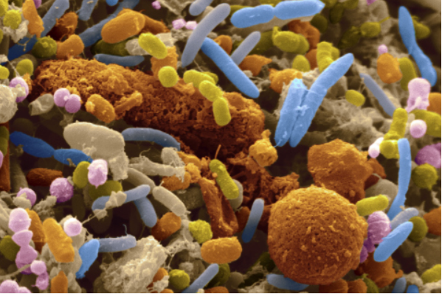
NGS short-read sequencing: Different data types
Given a community of bacteria in any given habitat (soil, gut, ocean, …) we want to know:
WHO IS THERE?
AT WHAT PROPORTIONS?
WHAT ARE THEY DOING?

Slide 30
NGS short-read sequencing: Different data types
Meta-barcoding (metaB)
Meta-genomics (metaG)
Meta-transcriptomics (metaT)
Seq approach
Seq material
Target
Taxonomic precision
Resolution

Slide 31
NGS short-read sequencing: Different data types
Meta-barcoding (metaB)
Meta-genomics (metaG)
Meta-transcriptomics (metaT)
Seq approach
Seq material
Target
Taxonomic precision
Resolution
Targeted
Amplicon DNA
Bacterial genomes
Genus/Species
Higher
Non-targeted
Whole genomic DNA
All genomes
Strain/Genome
Lower
Non-targeted
Transcribed RNA
All active genomes
Strain/Genome
Lower

Slide 32
NGS short-read sequencing: Different data types
Meta-barcoding (metaB)
Meta-genomics (metaG)
Meta-transcriptomics (metaT)
Seq approach
Seq material
Target
Taxonomic precision
Resolution
Targeted
Amplicon DNA
Bacterial genomes
Genus/Species
Higher
Non-targeted
Whole genomic DNA
All genomes
Strain/Genome
Lower
Non-targeted
Transcribed RNA
All active genomes
Strain/Genome
Lower

Slide 33

NGS short-read sequencing: MetaB
Goal: Identify the members of a bacterial community and its composition
Method: …

Slide 34
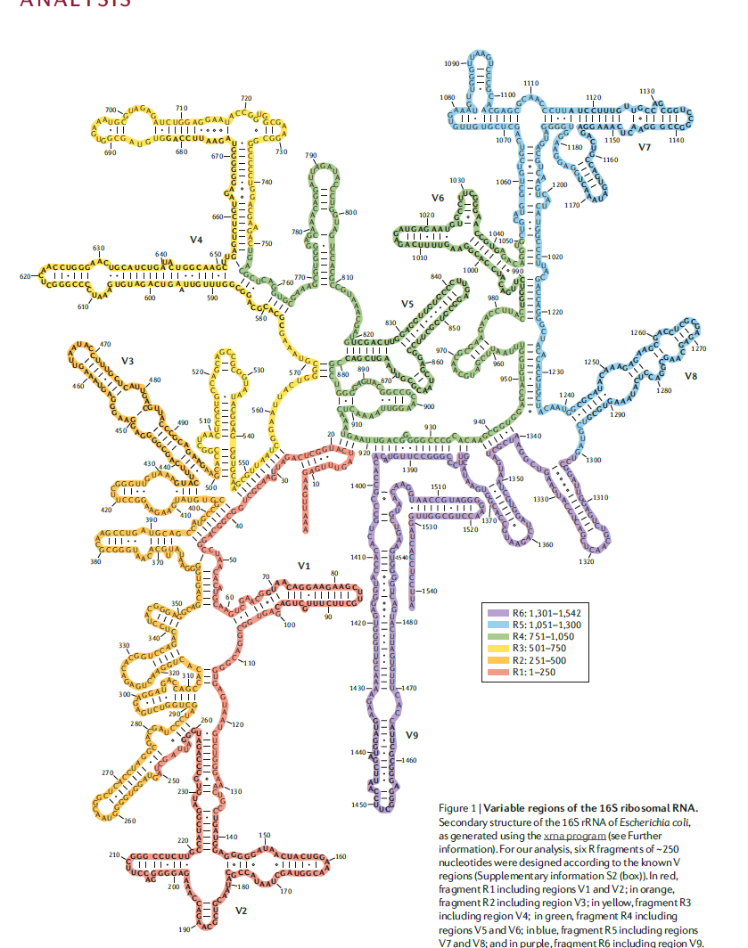
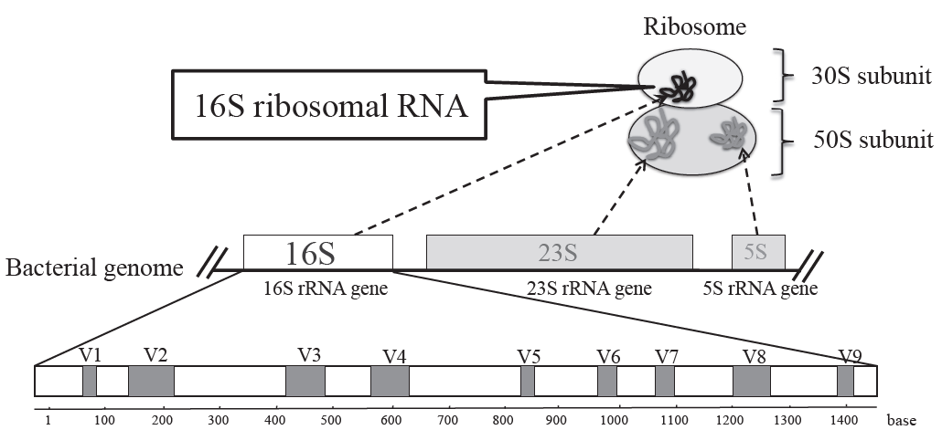
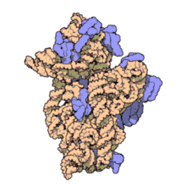
NGS short-read sequencing: MetaB
Goal: Identify the members of a bacterial community and its composition
Method: PCR amplification of (part of) bacterial universal marker gene
The 16S rRNA gene (part of prokaryotic ribosome)
Secondary structure of the 16S rRNA
V4
V6
V7
V5
+ proteins
V3
V8
Conserved region
Hypervariable region*
ribosomal proteins
16S rRNA
V1
*Form helical structures, which allow for considerable sequence variation
V2
Fukuda et al. (2016) Molecular approaches to studying microbial communities: Targeting the 16S ribosomal RNA gene Journal of UOEH 38(3): 223-232
Yarza et al. (2014) Uniting the classification of cultured and uncultured bacteria and arachae using 16S rRNA gene sequences Nature Reviews Microbiology 12: 635-645

Slide 35
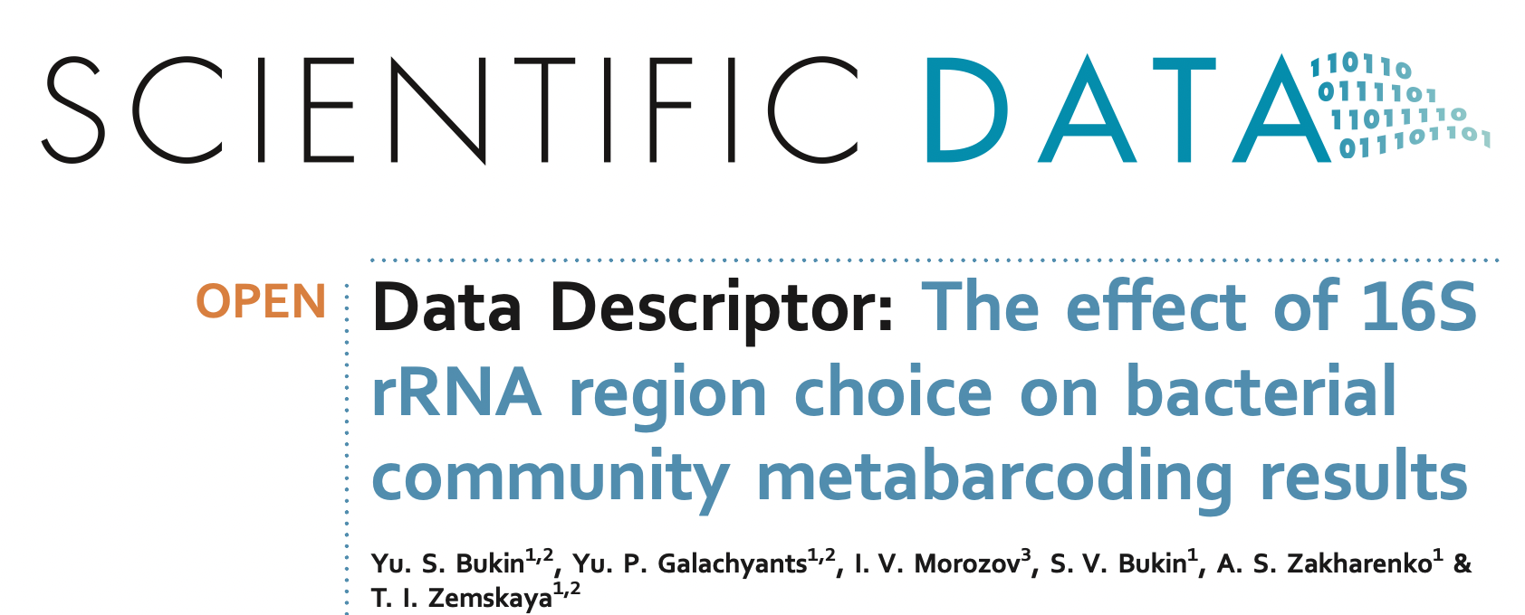
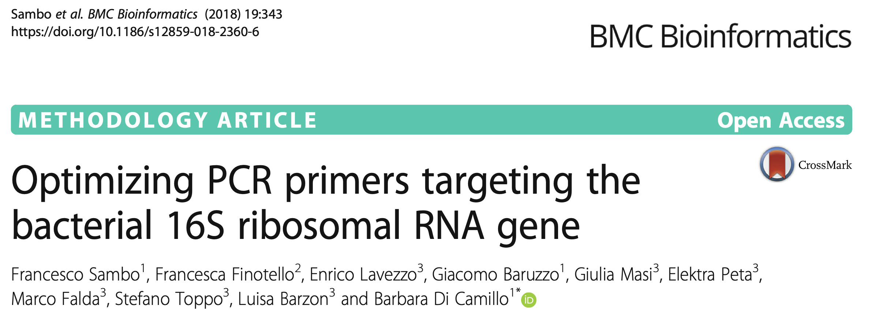
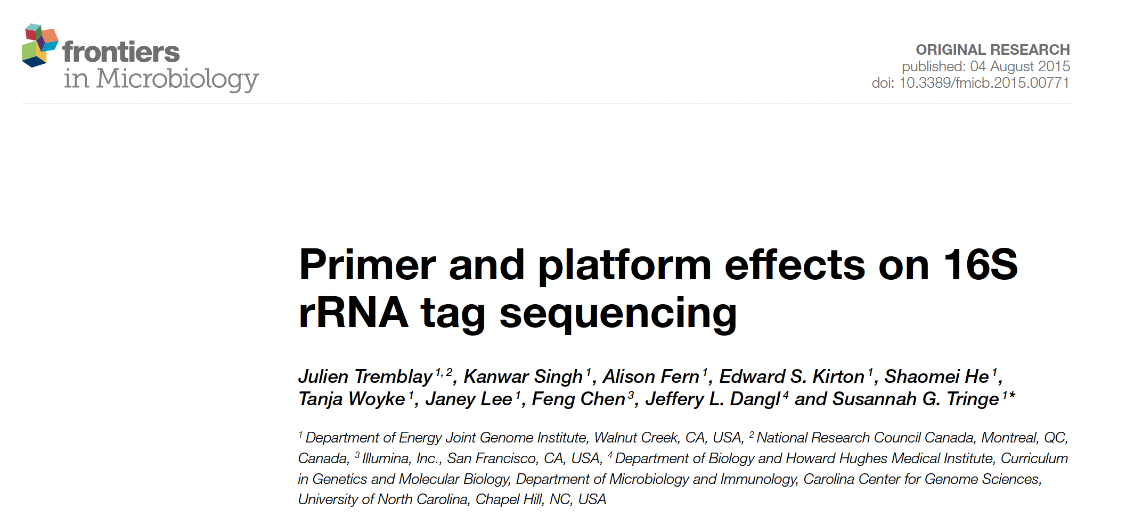
NGS short-read sequencing: MetaB
Goal: Identify the members of a bacterial community and its composition
Method: PCR amplification of (part of) bacterial universal marker gene
The 16S rRNA gene (part of prokaryotic ribosome)
Conserved region → ideal as primer binding sites!
Hypervariable region* → ideal to resolve sequence variation in bacterial population
*Form helical structures, which allow for considerable sequence variation
Fukuda et al. (2016) Molecular approaches to studying microbial communities: Targeting the 16S ribosomal RNA gene Journal of UOEH 38(3): 223-232
Yarza et al. (2014) Uniting the classification of cultured and uncultured bacteria and arachae using 16S rRNA gene sequences Nature Reviews Microbiology 12: 635-645

Slide 36
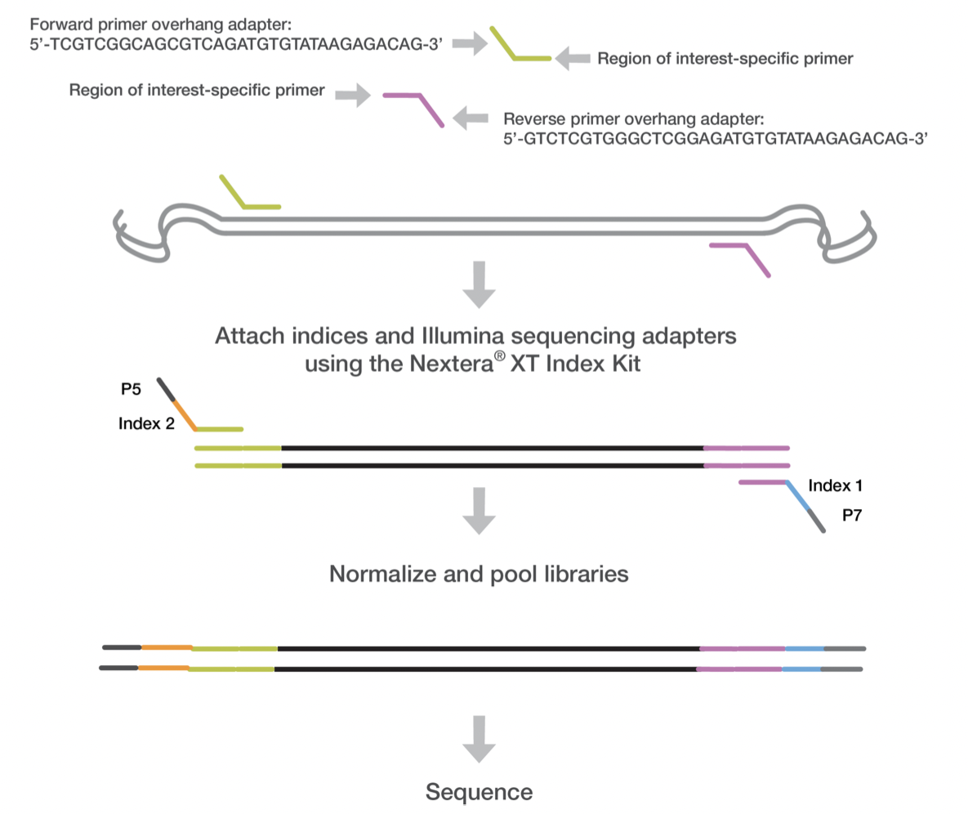
NGS short-read sequencing: MetaB
Goal: Identify the members of a bacterial community and its composition
Method: PCR amplification of (part of) bacterial universal marker gene
Template DNA strands
PCR1
PCR amplified target region
PCR2
PCR amplified final amplicon
https://support.illumina.com/documents/documentation/chemistry_documentation/16s/16s-metagenomic-library-prep-guide-15044223-b.pdf

Slide 37
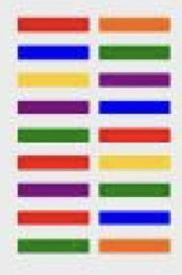
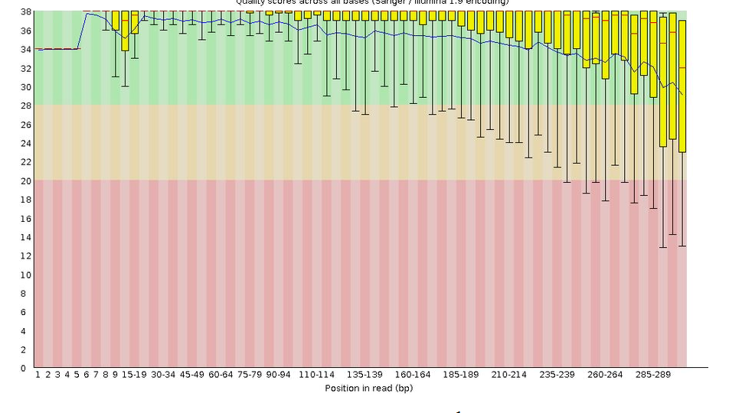
NGS short-read sequencing: MetaB
Data analysis pipeline
Individual reads
Read clustering
Read QC
Error correction
http://web.cbio.uct.ac.za/~gerrit/slides/data_analysis_of_16S_rRNA_gene_amplicons_uct.pdf

Slide 38
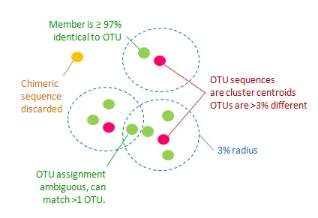
NGS short-read sequencing: MetaB
Data analysis pipeline
Individual reads
Read clustering
Read QC
Error correction
Generation of operational taxonomic units (OTUs)
https://drive5.com/usearch/manual/uparseotu_algo.html

Slide 39



NGS short-read sequencing: MetaB
Data analysis pipeline
Individual reads
Read clustering
Read QC
Error correction
Popular 16S rRNA gene analysis tools
Generation of operational taxonomic units (OTUs)
Mothur, University of Michigan
https://www.mothur.org/
Robert Edgar
http://www.drive5.com/usearch/
University of Colorado
http://qiime.org/
https://drive5.com/usearch/manual/uparseotu_algo.html

Slide 40

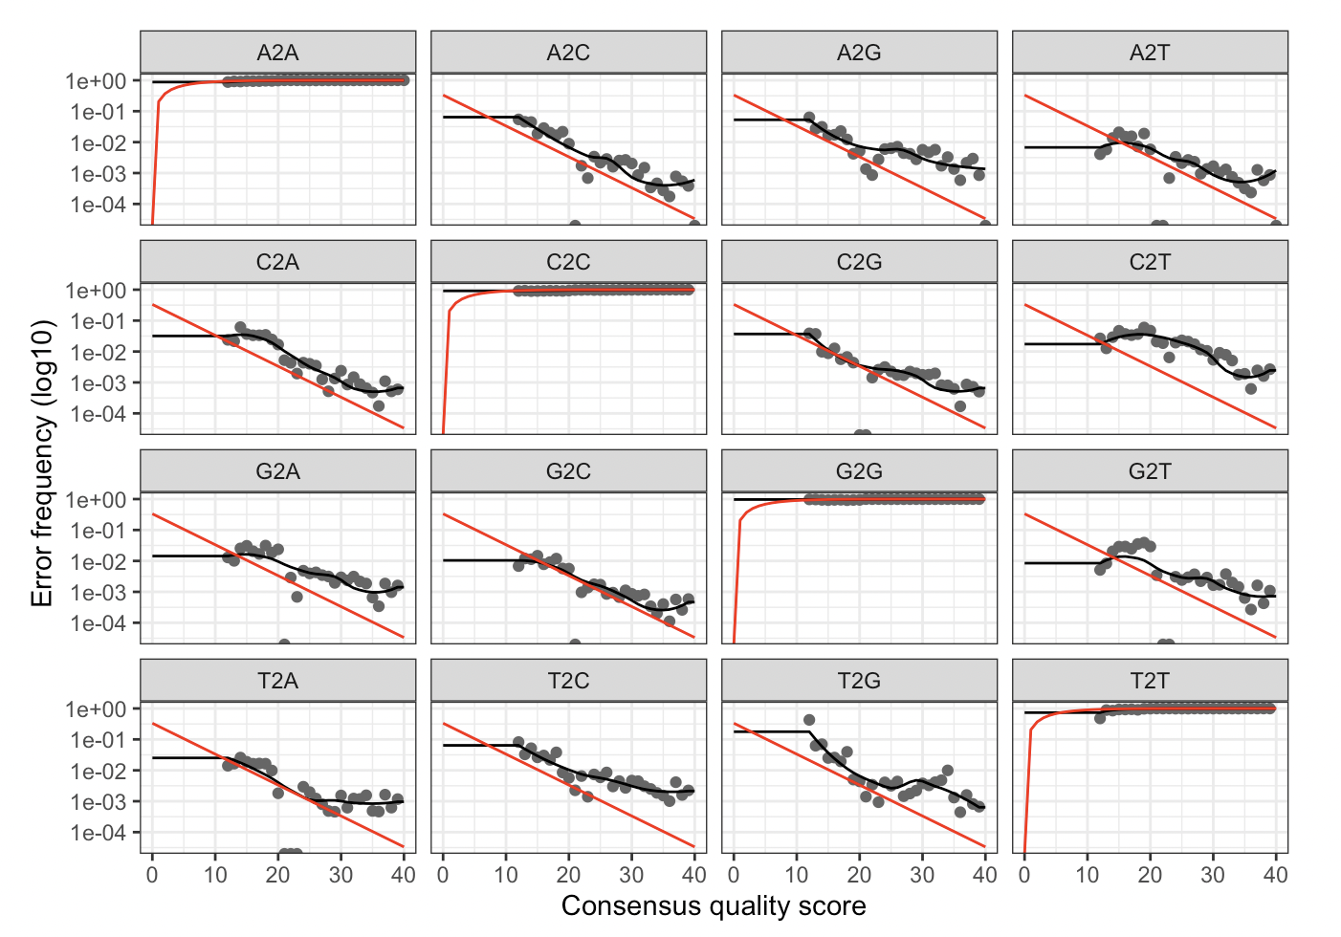
NGS short-read sequencing: MetaB
Data analysis pipeline
Individual reads
Read clustering
Read QC
Error correction
Learning the error model from the sequencing data:
Infer error rates for all possible nucleotide transitions per consensus quality score
black line represents the estimated error rates after convergence of the machine-learning algorithm
Inferred error model is used to correct individual reads (separately for forward and reverse read)
Merging of forward and reverse reads
Only identical consensus reads are grouped into Amplicon Sequence variants (ASVs)
https://benjjneb.github.io/dada2/tutorial.html

Slide 41
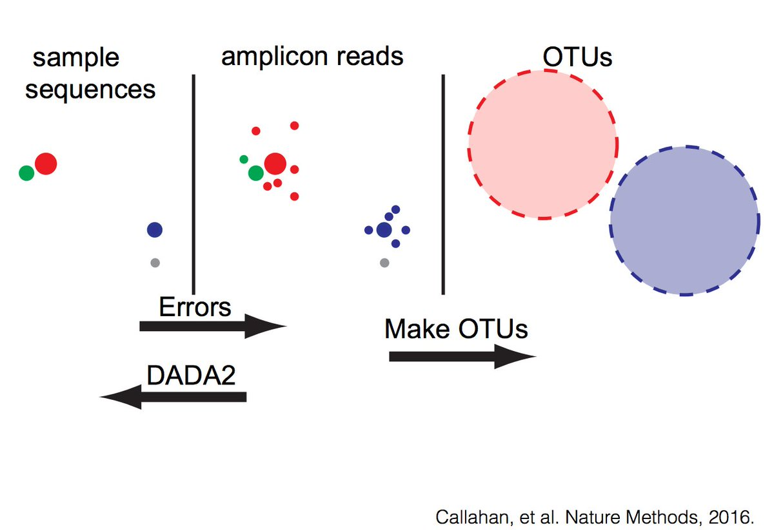
NGS short-read sequencing: MetaB
OTUs vs ASVs

Slide 42



NGS short-read sequencing: MetaB
Taxonomic annotation
Popular 16S rRNA gene databases
Taxonomy:
Kingdom
Phylum
Class
Order
Family
Genus
Species
University of Michigan
https://rdp.cme.msu.edu/
LBNL Berkeley,
now second genomes
http://greengenes.lbl.gov
MPI Bremen
https://www.arb-silva.de/
https://drive5.com/usearch/manual/uparseotu_algo.html

Slide 43
NGS short-read sequencing: MetaB
Community structure analysis
Relative abundances
note: suffers from
problem of compositionality
Alpha-diversity
ecologically defined as
a function of the number of
species (richness) and the
evenness of species distribution
Beta-diversity
analysis of between-
community dissimilarity

Slide 44
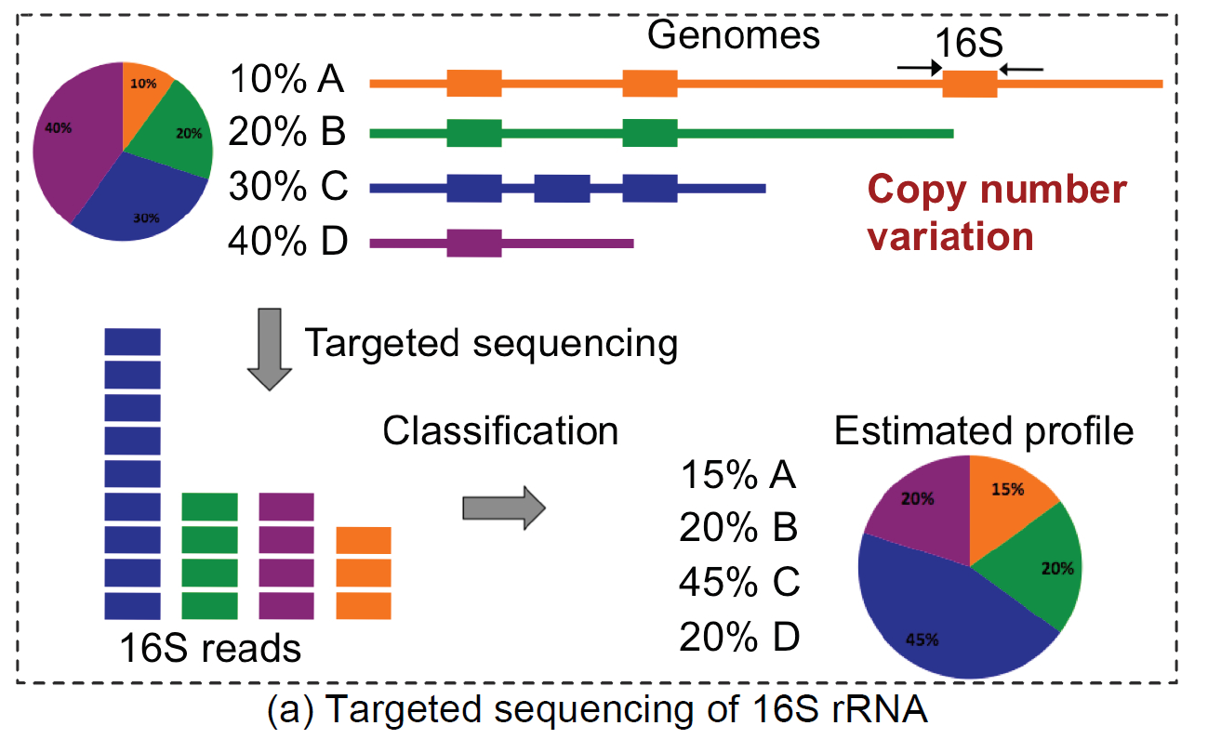
NGS short-read sequencing: MetaB
Caveat of multiple 16S rRNA gene copies

Slide 45
NGS short-read sequencing: Different data types
Meta-barcoding (metaB)
Meta-genomics (metaG)
Meta-transcriptomics (metaT)
Seq approach
Seq material
Target
Taxonomic precision
Resolution
Targeted
Amplicon DNA
Bacterial genomes
Genus/Species
Higher
Non-targeted
Whole genomic DNA
All genomes
Strain/Genome
Lower
Non-targeted
Transcribed RNA
All active genomes
Strain/Genome
Lower

Slide 46
NGS short-read sequencing: MetaG
Goal: Identify the genomic content of a community, its composition and function
Method: …

Slide 47
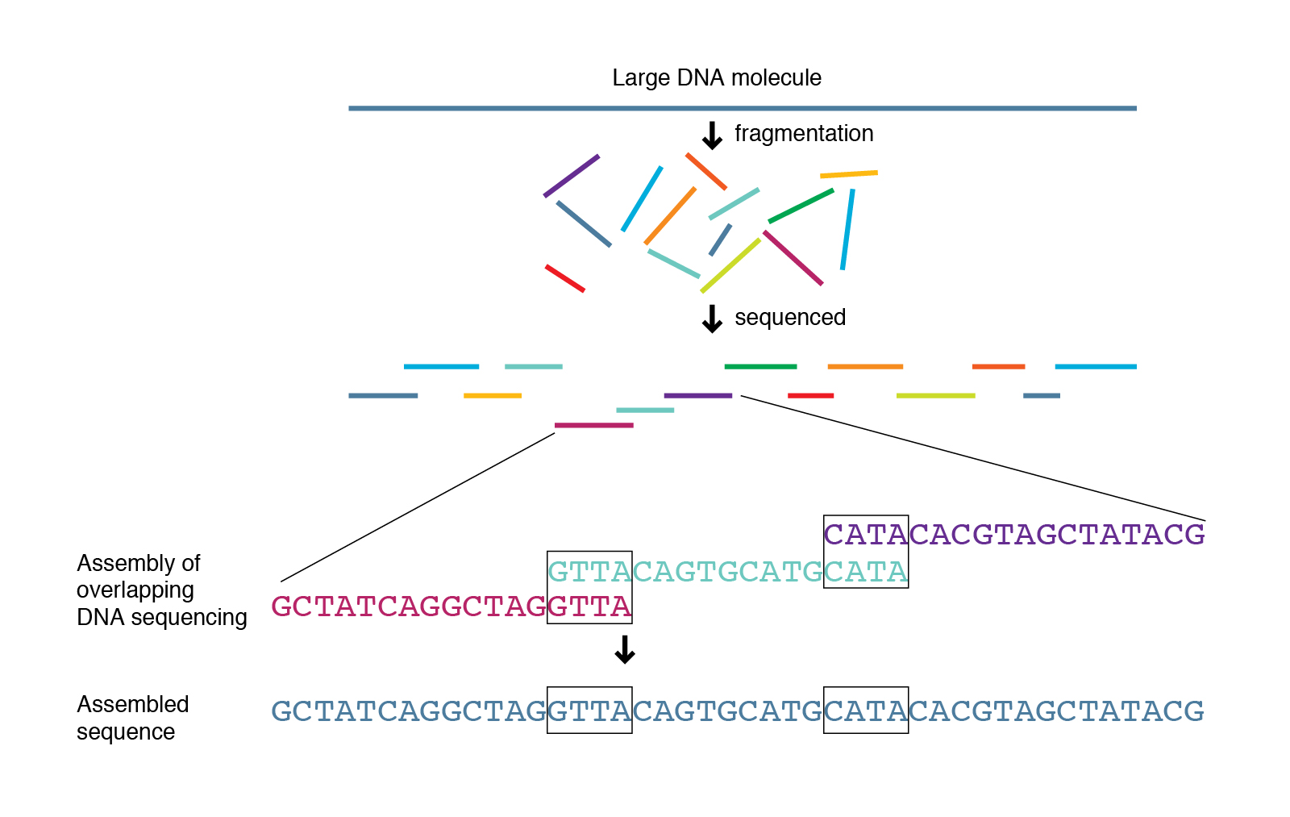
NGS short-read sequencing: MetaG
Goal: Identify the genomic content of a community, its composition and function
Method: Shotgun sequencing

Slide 48
NGS short-read sequencing: MetaG
Goal: Identify the genomic content of a community, its composition and function
Method: Shotgun sequencing
*Can be from bacteria, virus, fungus, human, mouse, …
*Targeted depletion possible
https://www.genome.gov/genetics-glossary/Shotgun-Sequencing

Slide 49
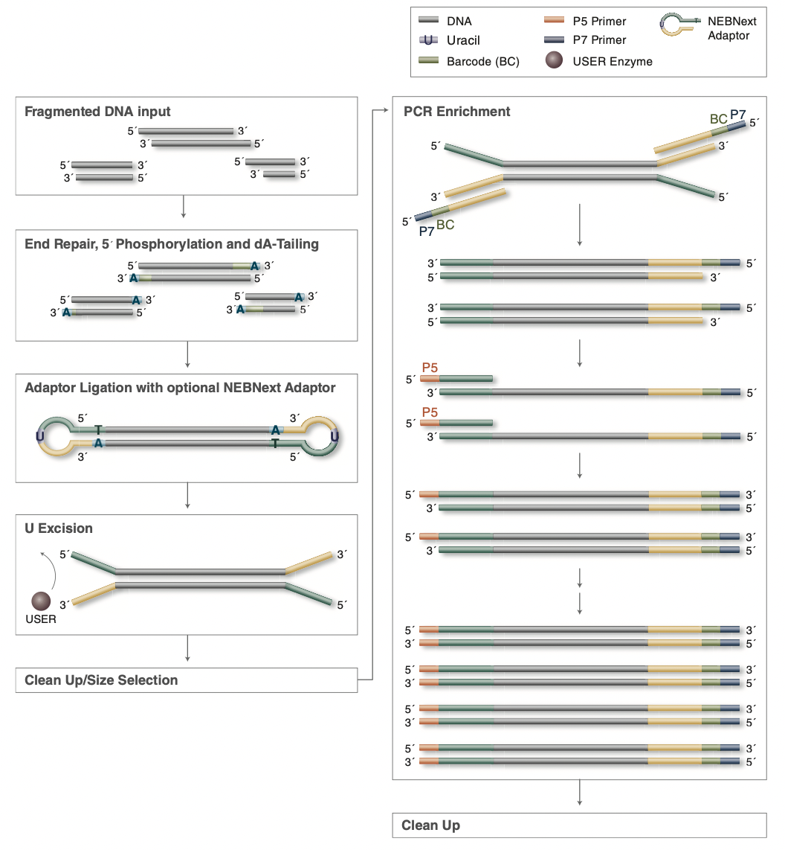
NGS short-read sequencing: MetaG
Sequencing
https://international.neb.com/-/media/nebus/files/manuals/manuale7103-e7645.pdf?rev=339d6c65a9314c9e988851a9d671fd9a&hash=2AF765847CD54F1B7464205F7920A50F

Slide 50
NGS short-read sequencing: MetaG
Size-selection is required as read-length is fixed!
Sequencing
https://international.neb.com/-/media/nebus/files/manuals/manuale7103-e7645.pdf?rev=339d6c65a9314c9e988851a9d671fd9a&hash=2AF765847CD54F1B7464205F7920A50F

Slide 51
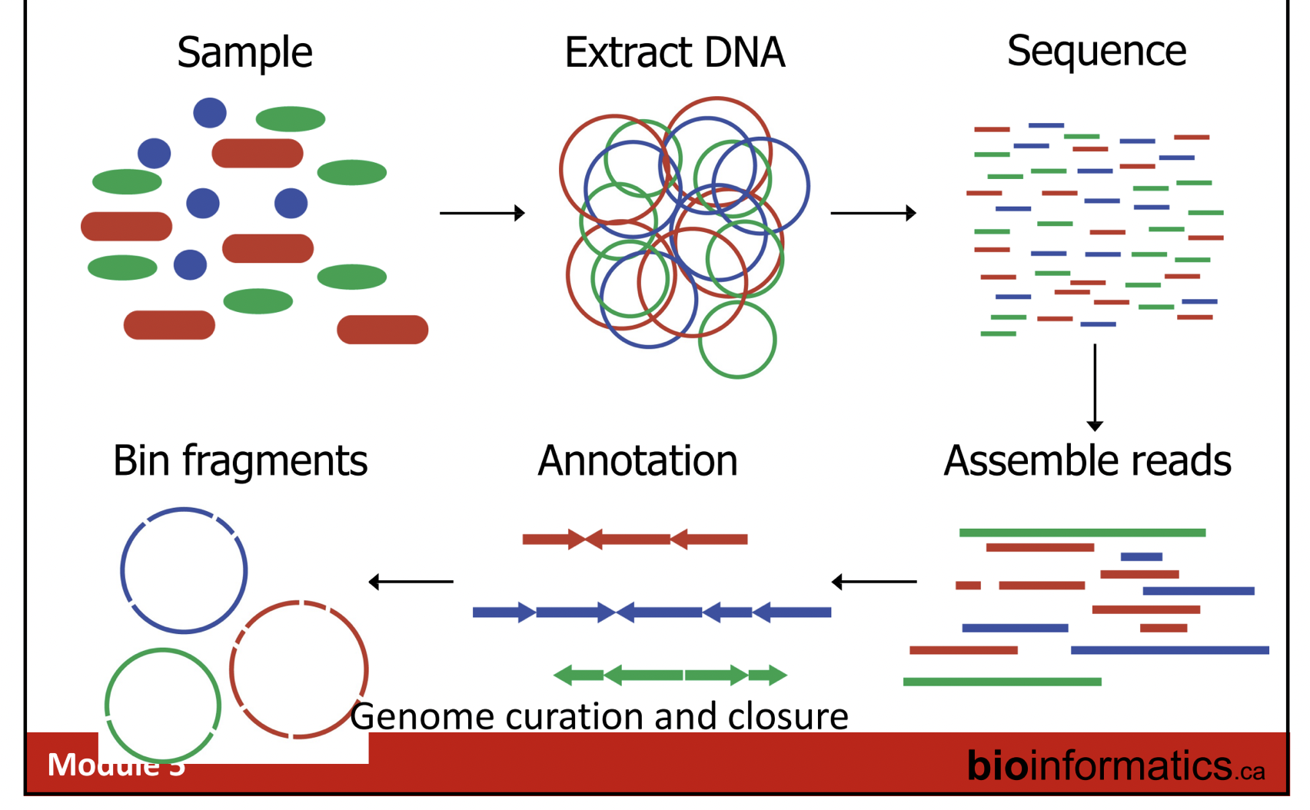
NGS short-read sequencing: MetaG
Data analysis pipeline
Individual reads
Assembled reads
Remove sequencing adaptors
Quality trimming of reads
Remove unwanted reads (human, mouse, etc.)
Read QC
Assembly
Gene calling
MAGs*
Annotated scaffolds
Binning
*Metagenome-assembled genomes
→ More this afternoon from Lucas
https://bioinformatics.ca/workshops/2018-analysis-of-metagenomic-data/

Slide 52
NGS short-read sequencing: MetaG
Data analysis pipeline
Individual reads
Assembled reads
Remove sequencing adaptors
Quality trimming of reads
Remove unwanted reads (human, mouse, etc.)
Read QC
Assembly
Gene calling
MAGs*
Annotated scaffolds
Binning
*Metagenome-assembled genomes
→ More this afternoon from Lucas
https://bioinformatics.ca/workshops/2018-analysis-of-metagenomic-data/

Slide 53
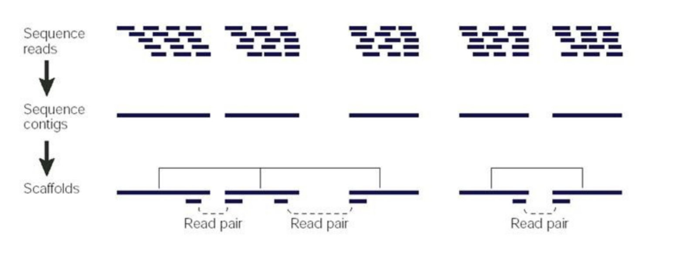
NGS short-read sequencing: MetaG
Data analysis pipeline
https://bioinformatics.ca/workshops/2018-analysis-of-metagenomic-data/

Slide 54
NGS short-read sequencing: MetaG
Data applications

Slide 55
NGS short-read sequencing: MetaG
Data applications
Accurate microbial abundance estimation using marker genes
Increased taxonomic resolution
Linking function to phenotype

Slide 56
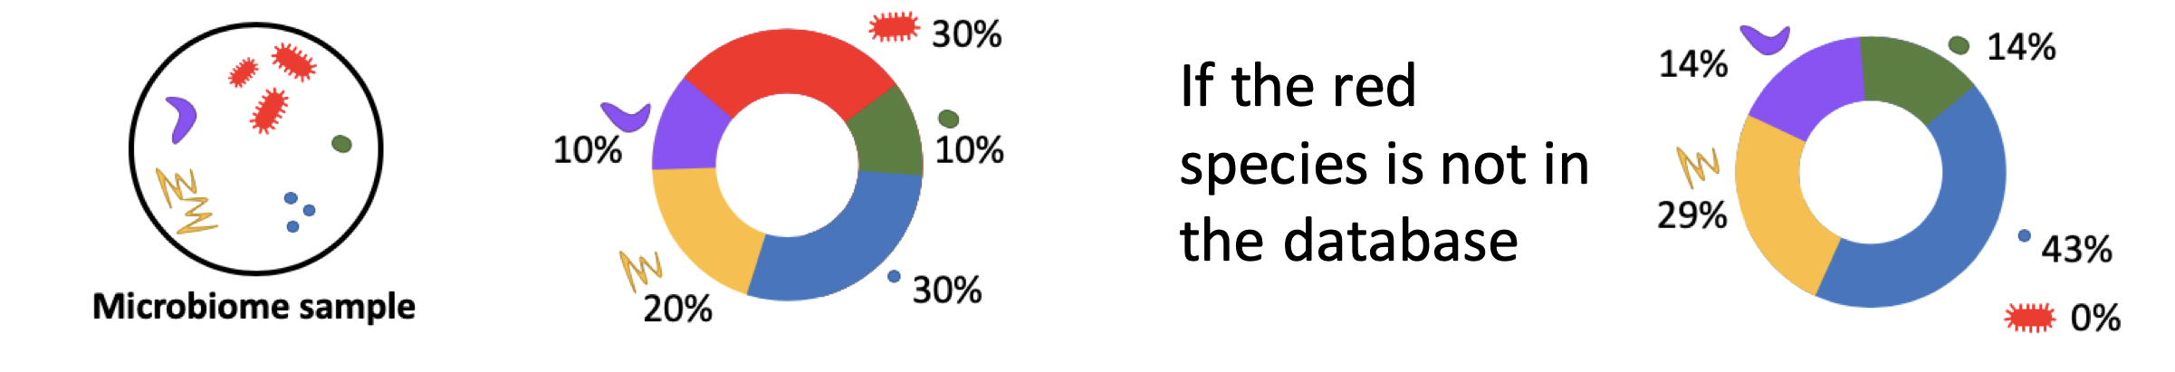
NGS short-read sequencing: MetaG
Accurate microbial abundance estimation using marker genes
Common problems when using metaB data:
Variation in 16S copy number
Taxonomic annotation is database-dependent
Further:
Genomes from different species can be up to 95% identical¹ → hard to map reads of length 100-150 to the original genome
Genomes have different length
¹Jain et al. Nature Comm. (2018)

Slide 57

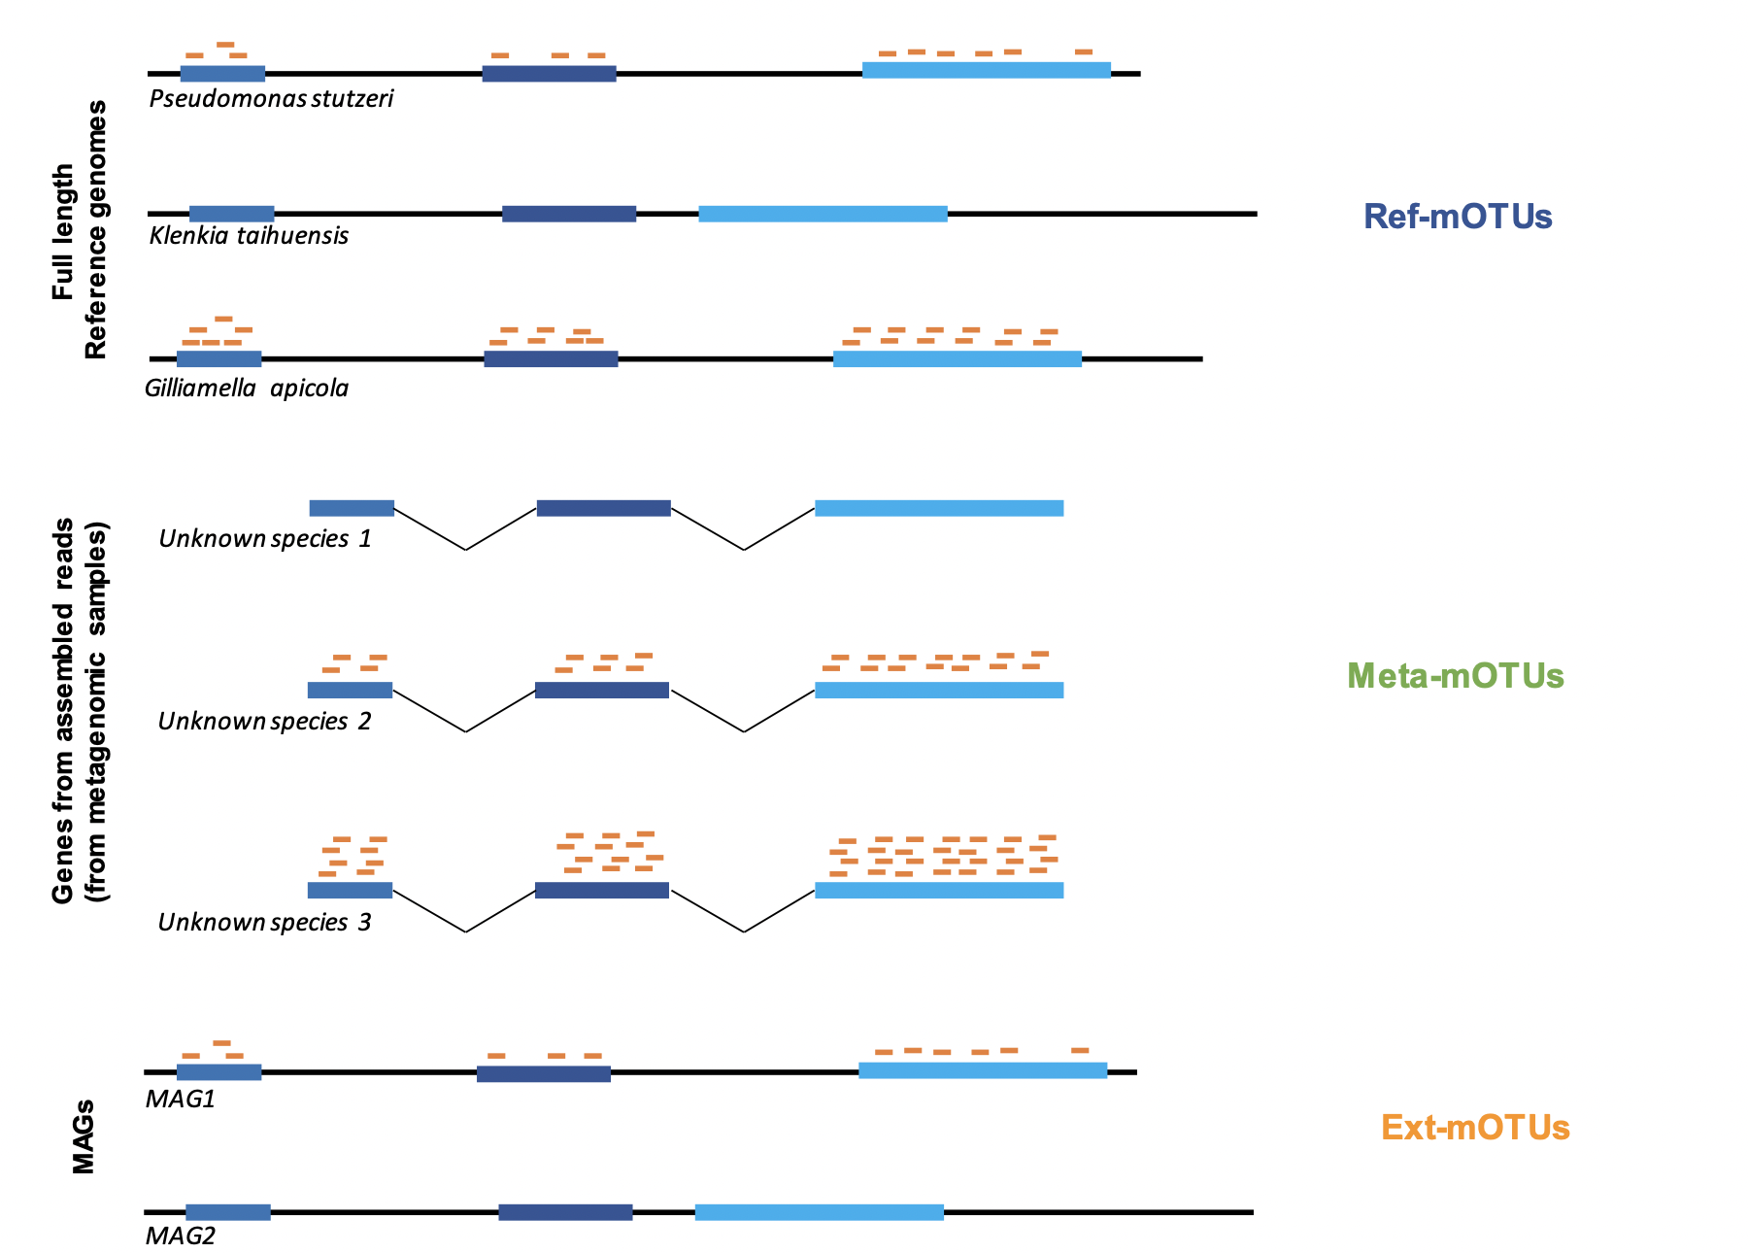
NGS short-read sequencing: MetaG
Accurate microbial abundance estimation using marker genes
Solution: Single-copy universal marker genes
Present in almost all known organisms
Only one copy within each genome
1x
Uses 10 universal single-copy marker genes (here 3 are represented)
2x
Map metagenomic reads to marker genes using
Reference genomes
Sunagawa et al. Nature methods (2013); Milanese et al. Nature comm (2019)

Slide 58
NGS short-read sequencing: MetaG
Accurate microbial abundance estimation using marker genes
Solution: Single-copy universal marker genes
Present in almost all known organisms
Only one copy within each genome
1x
Uses 10 universal single-copy marker genes (here 3 are represented)
2x
2x
Map metagenomic reads to marker genes using
Reference genomes
Assembled and linked contigs
4x
Sunagawa et al. Nature methods (2013); Milanese et al. Nature comm (2019)

Slide 59
NGS short-read sequencing: MetaG
Accurate microbial abundance estimation using marker genes
Solution: Single-copy universal marker genes
Present in almost all known organisms
Only one copy within each genome
1x
Uses 10 universal single-copy marker genes (here 3 are represented)
2x
2x
Map metagenomic reads to marker genes using
Reference genomes
Assembled and linked contigs
MAGs
4x
1x
Sunagawa et al. Nature methods (2013); Milanese et al. Nature comm (2019)

Slide 60
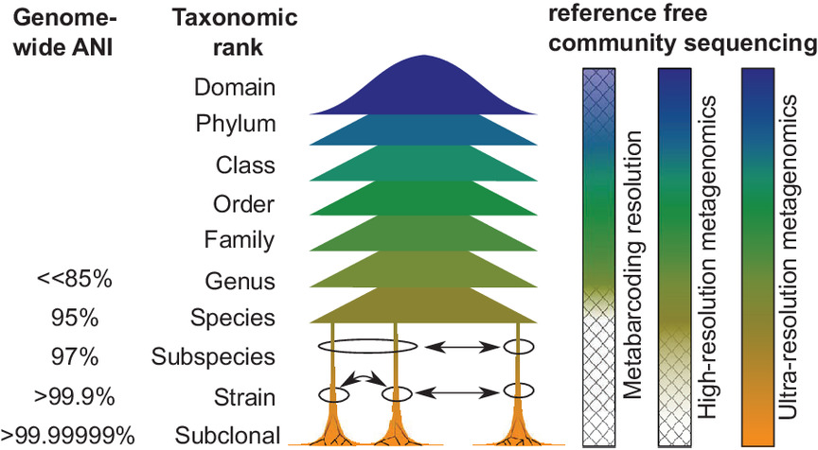
NGS short-read sequencing: MetaG
Increased taxonomic resolution
Hildebrand (2021) mSystems 6(4) e00881-21

Slide 61
NGS short-read sequencing: MetaG
Increased taxonomic resolution
Hildebrand (2021) mSystems 6(4) e00881-21

Slide 62
NGS short-read sequencing: MetaG
Increased taxonomic resolution
Hildebrand (2021) mSystems 6(4) e00881-21

Slide 63
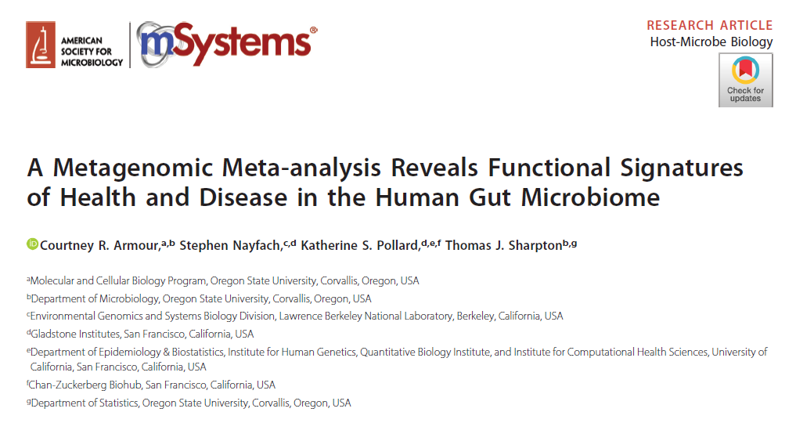
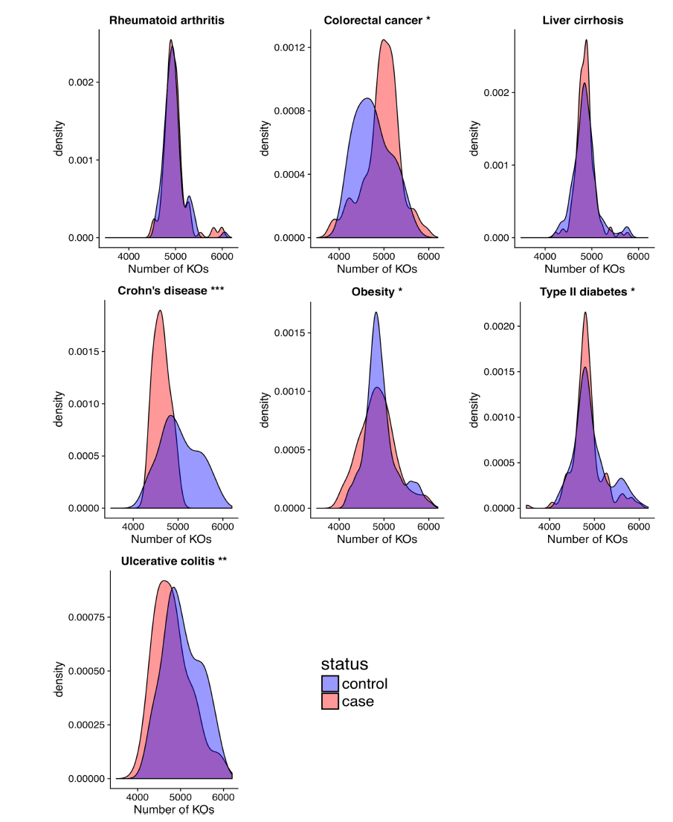
NGS short-read sequencing: MetaG
Linking function to phenotype
FIG 1 Protein family richness associates with disease. Density plots of the distribution of protein family richness across case and control populations for seven diseases. Asterisks beside plot titles indicate significance from Student’s t test (*, P0.05; **, P0.01; ***,
P0.001)
Armour, R., Nayfach, S., Pollard, K.S., Sharpton, T.J. (2019) mSystems 4(4) e00332-18

Slide 64
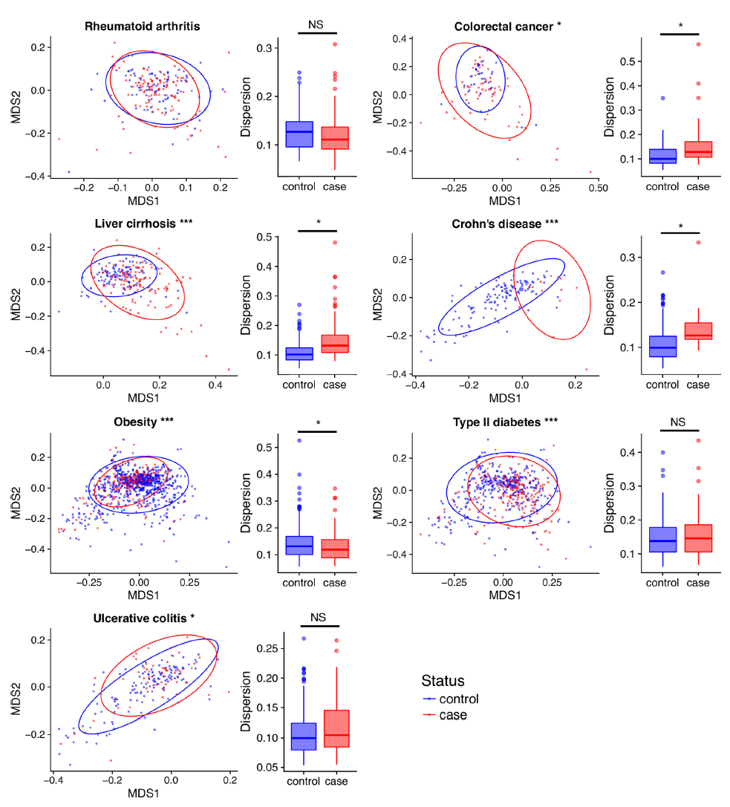
NGS short-read sequencing: MetaG
Linking function to phenotype
Shown are MDS plots based on Bray-Curtis dissimilarity between all samples based on their KO abundances
functional composition of the gut microbiome differs between case and control populations for 6 out of 7 diseases
FIG 2 Changes in functional composition associate with disease. NMDS plots of Bray-Curtis dissimilarity between cases and controls across diseases; ellipses represent 95% confidence level. Asterisks in NMDS plot titles indicate significance from PERMANOVA (***, P0.001; Table S6). Box plots represent dispersion in beta-diversity within groups. Asterisks in box plots denote significance from P test and ANOVA (*, P 0.05).
Armour, R., Nayfach, S., Pollard, K.S., Sharpton, T.J. (2019) mSystems 4(4) e00332-18

Slide 65
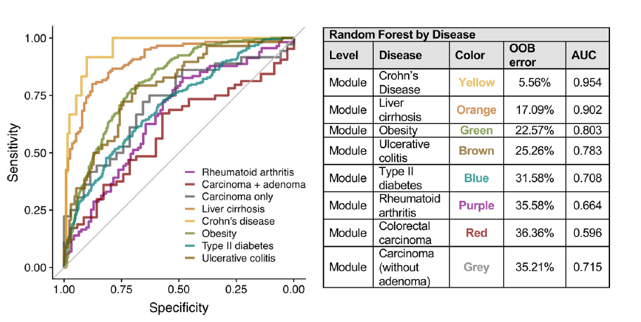
NGS short-read sequencing: MetaG
Linking function to phenotype
“These results suggest that the potential for use of the functional composition of the gut microbiome in disease diagnosis varies by the type and severity of disease”
FIG 4 Classifying disease status based on the functional composition of the microbiome. ROC curves from random forest classifiers for cases and controls in each disease. The table shows OOB error and AUC values.
Armour, R., Nayfach, S., Pollard, K.S., Sharpton, T.J. (2019) mSystems 4(4) e00332-18

Slide 66
NGS short-read sequencing: Different data types
Meta-barcoding (metaB)
Meta-genomics (metaG)
Meta-transcriptomics (metaT)
Seq approach
Seq material
Target
Taxonomic precision
Resolution
Who is there?
At what proportions?
What are they doing?
Targeted
Amplicon DNA
Bacterial genomes
Genus/Species
Higher
Non-targeted
Whole genomic DNA
All genomes
Strain/Genome
Lower
Non-targeted
Transcribed RNA
All active genomes
Strain/Genome
Lower

Slide 67
NGS short-read sequencing: Different data types
Meta-barcoding (metaB)
Meta-genomics (metaG)
Meta-transcriptomics (metaT)
Seq approach
Seq material
Target
Taxonomic precision
Resolution
Who is there?
At what proportions?
What are they doing?
Targeted
Amplicon DNA
Bacterial genomes
Genus/Species
Higher
Yes
Yes (with limitations)
No
Non-targeted
Whole genomic DNA
All genomes
Strain/Genome
Lower
Yes
Yes
Yes (metabolic potential)
Non-targeted
Transcribed RNA
All active genomes
Strain/Genome
Lower
Yes, if active
Yes if normalized with metaG
Yes

Slide 68
SUMMARY
Different DNA sequencing technology have been developed over the last 30 years
Different sequencing technologies still in use today for specific applications/questions
Usually there is a trade-off between throughput and accuracy (but still improving) → needs to be tailored to research question
Different technologies generate different data types with individual characteristics (Pros and Cons) → needs to be tailored to research question
Meta-barcoding: Cheap, abundance-independent, limited taxonomic resolution, no functional information
Meta-genomics: expensive, abundance-dependent, high taxonomic resolution, functional information

Slide 69
Break…

Slide 70
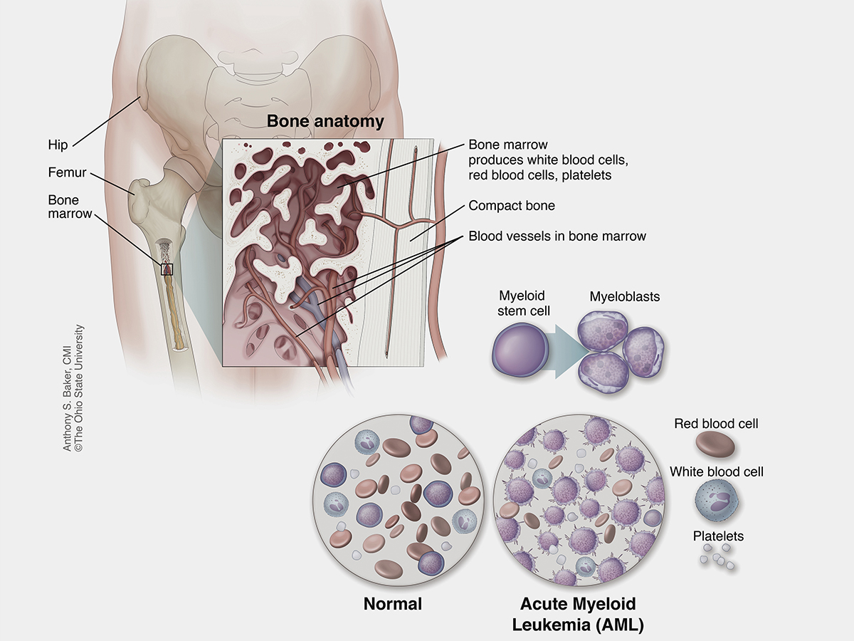
Block-course study data: The gut microbiome in acute myeloid leukemia (AML)
AML = Acute myeloid leukemia
Cancer of the blood and bone marrow that progresses quickly and always ends in death if untreated
Increased incidence with age
Different genetic variants known to affect treatment outcome
Current best treatment approach: Intensive chemotherapy
Less room for healthy cells
→ Frequent infections, anemia, bleeding…

Slide 71
Block-course study data: Impact of intestinal microbiota on systemic infections, response to chemotherapy and overall outcomes in patients with acute myeloid leukemia – a prospective, non-interventional, single-center study
Intensive chemotherapy
highly toxic (Gastrointestinal mucositis with enterocolitis extremely common)
high risk of life-threatening infections during neutropenia
Gut is main source of bacteria causing infections → use of antibiotics/gut decontamination
Overall benefit of gut decontamination unknown
Dysbiosis of the gut microbiome caused by gut decontamination might aggravate patient susceptibility to infection
Bottom line: “The impact of intensive chemotherapy with/without prophylactic gut decontamination on the microbiota, systemic infections and leukemia response in AML patients has not been clarified”

Slide 72

Block-course study data: Impact of intestinal microbiota on systemic infections, response to chemotherapy and overall outcomes in patients with acute myeloid leukemia – a prospective, non-interventional, single-center study
Study design
~day 0
~day 8-12
~day 23-33
~day 45-50
~day 60-75
3-4 months

Slide 73
NGS long-read sequencing: MetaB and MetaG
…

